Slide 1
“..The Joy of the Lord Is Our Strength”
Nehemiah. 8:10

Slide 2

Weekly Bulletin
Calivigny Gospel Hall
Sunday 01st November 2026

Slide 3
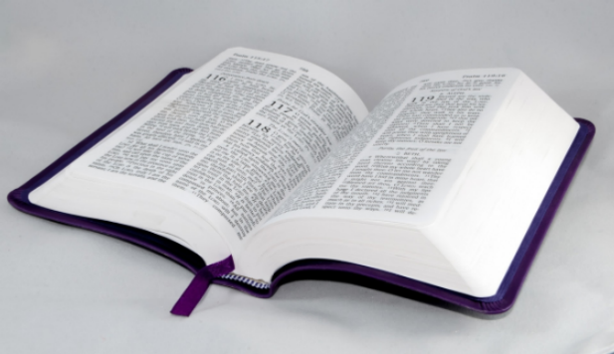
A warm welcome as you join us today In the Name of our Lord and Saviour Jesus Christ.

Slide 4
Programme
The Lord’s Supper -10.00 a.m.
Open Sunday School -10.45 a.m.

Slide 5
Song Leader: Bro. Matthew Strachan
Announcer: Bro. Lyndon Nelson
Speaker: Bro. Allan Neptune

Slide 6

Remember the Suggestions & Camp Site Boxes

Slide 7
Building Project | CONTRIBUTE TO THE FURNISHING OF THE KITCHEN & DINING FACILITIES

Slide 8

Birthday and Anniversary Greetings to those celebrating this week:
  Sis. Tiffany Joseph –02nd November;

Slide 9
Obituary
Bro. Herbert Morain;

Slide 10
Special Prayer for the Sick:
Sis. Odelle Finlay; Bro. Tyron James;
Bro. Peter Simon; Bro. Carl Worrell (Canada); Bro. Alban Strachan;
Bro. Hudson McPhail;
Bro. Hensley Francis;
Bro. Darius Lewis (USA);

Slide 11
Special Prayer for the Sick Cont’d:
Sis. Hannah Sargeant (Barbados);
Bro. Joseph Jeremiah (USA);
Bro. Cyril J. Lallion (Canada);
Continued prayers for Jennifer Telesford as she faces some post-surgery challenges.
Prayers for recovery after surgery for Sacha (Daughter of Bro. & Sis. Richardson- Bermuda)

Slide 12
Special Prayer:
Bro. Tony Telesford (Trinidad, Prostate Cancer); Bro. Matthew Edwards (Gouyave/UK);
Sis. Etheline Lawrence (Carriacou); Sis. Lyneith Romain;
Sis. Rhoda Rouse(NY); Sis. Claire Banfield;
Sis. Mahera Nelson; Sis. Eslyn Whint;

Slide 13
Special Prayer Cont’d:
Sis. Kareen Bernard; Sis. Ruth Rouse;
Sis. Beryl Rouse; Sis. Winnifred Marshall;
Sis. Wendy George & Family;
Sis. Karleen Bowen;
Sis. Annette Whint;
Sis. Shatonya Andrews;

Slide 14
Special Prayer Cont’d:
Bro. Emmanuel Simon;
Bro. Eddie Richardson (Bermuda);
Bro. & Sis. Victor Gill (NY);
Sis. Pearla Alexis (UK);
Bro. Walton Whint;
Bro. Desmond Anthony;

Slide 15
Special Prayer Cont’d:
Sis. Maureen Simon (NY);
Bro. Tom Turi & Daughter, Emily (USA); Ms. Valjean Alexander;
Mr. Thomas Lawrence (Carriacou);
Mr. Robert Sperry Charles;
Mr. Herman Mc Donald;

Slide 16
Special Prayer Cont’d:
Believers’ Families;
Brethren Assemblies (Grenada);
Young Converts;
Radio Programme (The Brethren Hour);
The Schools/Evangelistic Ministry;
Global Concerns; Regional Crime Rate;

Slide 17
Special Prayer Cont’d:
For countries facing Post-Disaster Recovery;
Cuba for Current Economic Situation;
Special Prayer for Grenada Elections;

Slide 18
Special Prayer For Those Abroad:
Mikael Redhead-Jamaica;
All our members residing abroad.

Slide 19
Weekly Services

Slide 20

Tuesday 3rd November
United Prayer Meeting - Perdmontemps
-7.00 p.m.

Slide 21

Saturday 07th November
Youth Meeting
-6.00 p.m.

Slide 22
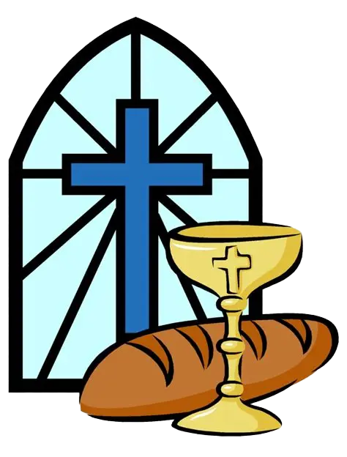
Sunday 08th November
Sunday School -10.00 a.m.
The Lord’s Supper -11.00 a.m.
Family Bible Hour -11.45 a.m.

Slide 23
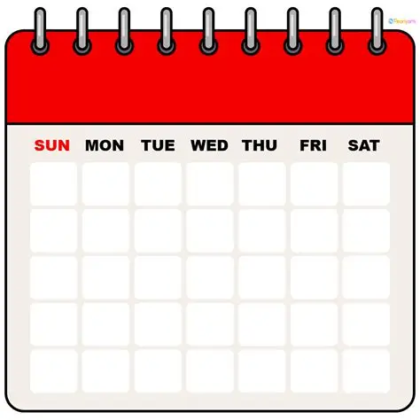
Calendar of Upcoming Events/Notices

Slide 24
Dedication of Babies –1st Sunday
Prison Ministry – 1st Sunday
***

Slide 25
Youth Week
November 29th to December 5th 2026
Theme: “Beauty begins in me”
Theme verse: 2 Corinthians 5:17
***

Slide 26
Ushers:
Cleaning Team 4: Sis. Lyneve Bailey;
Sis. Donna Neptune;

Slide 27
{Important Notice}
Kindly forward announcements for the Bulletin to:
Sis. Denise Simon/
Sis. Ruth Rouse/
Sis. Vanessa Da Breo
By Wednesday of this week.

Slide 28
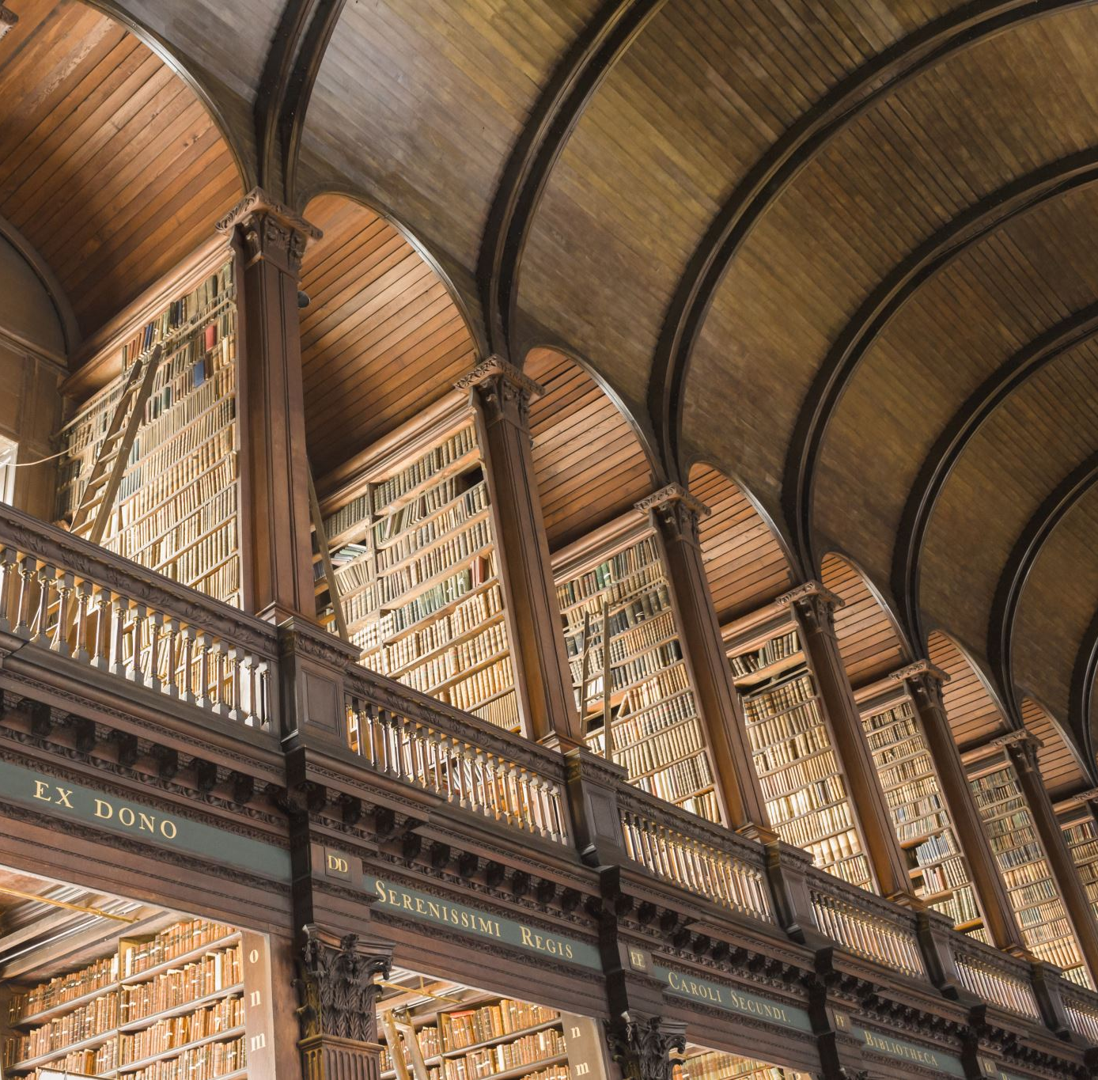
Calivigny gospel hall
Calivigny Gospel Hall was established in the early 1900s as one of the eight Brethren Assemblies in Grenada.

Slide 29
We assemble in the name of the Lord Jesus Christ and believe in Baptism by immersion and the
observance of the Lord’s Supper, as a memorial feast on a weekly basis.

Slide 30
Organizational Ronald Simon Allan Neptune Jeffrey Neptune Allan Neptune Johnell Mitchell Daniel Ross | Structure Elder Deacon Deacon Sunday School Superintendent Youth Director Full Time Worker

Slide 31
Calivigny Gospel Hall
Calivigny
St. George’s
Grenada
Phone: 1-473-443-5387

Slide 32

E-mail: calivignyghgrenada@gmail.com
Website: http://www.calivignygospelhallgrenada.com

Slide 33
1 Timothy 2:1-2 (KJV)
1. “I exhort therefore, that, first of all, supplications, prayers, intercessions, and giving of thanks, be made for all men; 2. For kings, and for all that are in authority; that we may lead a quiet and peaceable life in all godliness and honesty.”

