Slide 1
“..The Joy of the Lord Is Our Strength”
Nehemiah. 8:10

Slide 2

Weekly Bulletin
Calivigny Gospel Hall
Sunday 18th October 2026

Slide 3
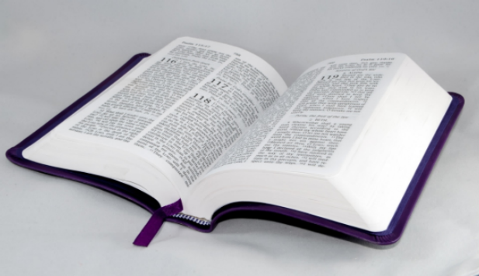
A warm welcome as you join us today
In the Name of our Lord and Saviour Jesus Christ.

Slide 4
Sunday School -10.00 a.m.
The Lord’s Supper -11.00 a.m.
Family Bible Hour -11.45 a.m.

Slide 5
Song Leader: Bro. Jeffrey Neptune
Announcer: Bro. Jeffrey Neptune
Speaker: Bro. Daniel Ross
Scripture Reading: Bro. Lyndon Nelson
Special: Sis. Donna Neptune

Slide 6
Remember the Suggestions & Camp Site Boxes& Camp Site Boxes
Remember the Suggestion & Camp Site Boxes

Slide 7
Building Project | CONTRIBUTE TO THE FURNISHING OF THE KITCHEN & DINING FACILITIES

Slide 8
Birthday and Anniversary Greetings to those celebrating this week:
Remember the Suggestion & Camp Site Boxes

Slide 9
Special Prayer for the Sick
Sis. Odelle Finlay; Bro. Tyron James;
Bro. Peter Simon; Bro. Carl Worrell (Canada); Bro. Alban Strachan;
Bro. Hudson McPhail;
Bro. Hensley Francis;
Bro. Darius Lewis (USA);

Slide 10
Special Prayer for the Sick Cont’d
Sis. Hannah Sargeant (Barbados);
Bro. Joseph Jeremiah (USA);
Bro. Cyril J. Lallion (Canada);
Continued prayers for Jennifer Telesford as she faces some post-surgery challenges.
Prayers for recovery after surgery for Sacha (Daughter of Bro. & Sis. Richardson- Bermuda)

Slide 11
Special Prayer
Bro. Tony Telesford (Trinidad, Prostate Cancer); Bro. Matthew Edwards (Gouyave, UK);
Sis. Etheline Lawrence(Carriacou);
Bro. Herbert Morain; Sis. Lyneith Romain;
Sis. Rhoda Rouse(NY); Sis. Claire Banfield;
Sis. Mahera Nelson; Sis. Eslyn Whint;

Slide 12
Special Prayer Cont’d
Sis. Kareen Bernard; Sis. Ruth Rouse;
Sis. Beryl Rouse; Sis. Winnifred Marshall;
Sis. Wendy George & Family;
Sis. Karleen Bowen;
Sis. Annette Whint;
Sis. Shatonya Andrews;

Slide 13
Special Prayer Cont’d
Bro. Emmanuel Simon;
Bro. Eddie Richardson (Bermuda);
Bro. & Sis. Victor Gill (NY);
Sis. Pearla Alexis (UK);
Bro. Walton Whint;
Bro. Desmond Anthony;

Slide 14
Special Prayer Cont’d
Sis. Maureen Simon (NY);
Bro. Tom Turi & Daughter, Emily (USA); Ms. Valjean Alexander;
Mr. Thomas Lawrence (Carriacou);
Mr. Robert Sperry Charles;
Mr. Herman Mc Donald;

Slide 15
Special Prayer Cont’d
Believers’ Families;
Brethren Assemblies (Grenada);
Young Converts;
Radio Programme (The Brethren Hour);
The Schools/Evangelistic Ministry;
Global Concerns; Regional Crime Rate;

Slide 16
Special Prayer Cont’d
For countries facing Post-Disaster Recovery;
Cuba for Current Economic Situation.

Slide 17
Special Prayer for those abroad
Bro. & Sis. Ronald Simon-USA;
Sis. Myntrude Sylvan-USA;
Mikael Redhead-Jamaica;
All our members residing abroad.

Slide 18
W e e k l y S e r v i c e s

Slide 19
Wednesday 21st October
Prayer/Ministry Meeting -7.00 p.m.

Slide 20
Saturday 24th October
Youth Meeting -6.00 p.m.

Slide 21
Sunday 25th October
Sunday School -10.00a.m.
The Lord’s Supper -11.00a.m.
Family Bible Hour -11.45a.m.

Slide 22
Calendar of Upcoming Events/Notices

Slide 23
Dedication of Babies –1st Sunday
Prison Ministry – 1st Sunday
***

Slide 24
Youth Week
November 29th to December 5th 2026
Theme: “Beauty begins in me”
Theme verse: 2 Corinthians 5:17
***

Slide 25
Ushers:
Cleaning Team 2: Sis. Wendy George;
Sis. Hazel Francis;

Slide 26
{Important Notice}
Kindly forward announcements for the Bulletin to:
Sis. Denise Simon/
Sis. Ruth Rouse/
Sis. Vanessa Da Breo
By Wednesday of this week.

Slide 27
Calivigny gospel hall
Calivigny Gospel Hall was established in the early 1900s as one of the eight Brethren Assemblies in Grenada.

Slide 28
We assemble in the name of the Lord Jesus Christ and believe in Baptism by immersion and the
observance of the Lord’s Supper, as a memorial feast on a weekly basis.

Slide 29
Organizational Ronald Simon Allan Neptune Jeffrey Neptune Allan Neptune Johnell Mitchell Daniel Ross | Structure Elder Deacon Deacon Sunday School Superintendent Youth Director Full Time Worker

Slide 30
Calivigny Gospel Hall
Calivigny
St. George’s
Grenada
Phone: 1-473-443-5387

Slide 31
E-mail: calivignyghgrenada@gmail.com
Website: http://www.calivignygospelhallgrenada.com

Slide 32
Ephesians 5:20 (KJV)
²⁰“ Giving thanks always for all things unto God and the Father in the name of our Lord Jesus Christ.”

